Slide 1
MANGUSTA 2016 DV day
Monte Romano, 28 novembre 2016
Gen. B. Roberto VANNACCI

Slide 2
MANGUSTA 2016
“Se insisti e resisti
Raggiungi e conquisti”

Slide 3
MANGUSTA 2016
1341 personale coinvolto di 3 FA e 4 nazioni
386 lanci di personale effettuati
3 Lanci di Carichi effettuati (1 CDS / 6 A7)
4 Assetti aerei FW impiegati per un totale di 10 ore di volo
4 assetti RW per un totale di 36 ore di volo
12 mezzi pesanti (Centauro)
90.000 5,56 a salve, 120 c.c. 105 TPT, 50 bomba da 81mm
3 Can. SAT su SICRAL1 +1 Can. SAT D.A.M.A. su SICRAL2
53 Km² di area interessata all’esercitazione
12 infortunati durante l’esercitazione
* Demand Assigned Multiple Access

Slide 4
MANGUSTA 2016
Take Away
STRATEGICO
VISION DELLA B.PAR. “FOLGORE”
OPERATIVO
SISTEMI DI COMANDO E CONTROLLO
COOPERAZIONE CON AM E JOINT PLANNING
TATTICO
BATTLE SPACE MANAGEMENT
COOPERAZIONE ARMA BASE/ARTIGLIERIA e altri supporti/enablers
TARGETING
SUB-TATTICO
TIRO
TOPOGRAFIA
PRESTANZA FISICA

Slide 5
AGENDA
EXERCISE SPECIFICATION
TRAINING OBJECTIVES
PARTICIPANTS
BLUFOR TASK ORGANIZATION
SCENARIO
AREA OF THE EXERCISE
OPERATIONAL OVERVIEW

Slide 6
EXERCISE SPECIFICATION
Purpose
Train and certify the Folgore Brigade (Airborne) as an Initial Entry Force in a Joint Forcible Entry (JFE) Operation in a semi-permissive or non-permissive environment in the initial (combat) stages of a Joint Campaign, deploying to the Area of Operation from an Italian national staging base or another appropriate Intermediate Staging Base (ISB) with limited Host Nation Support.
Theme
The Folgore Brigade will conduct offensive, defensive, and stability operations against a hybrid threat. After the JFE operation, the Task Force will hold and enlarge the airhead in preparation for follow-on-forces (FoF).
Exercise Design
Field Training Exercise (FTX), including Force-on-Force and Live Fire components. OPFOR will be directed by the EXCON cell (located inside the Brigade Headquarters).

Slide 7
BRIGADE TRAINING OBJECTIVES
Develop the employment concepts of a Forcible Entry TF.
Train Joint and Combined Land-Air Planning Process.
Validate the Command and Control (C2).
Validate the Targeting Process at the Brigade level.
Validate TTP’S specifically for Combat Support units.
Increase the level of interoperability with US and allied.
Validate the readiness for a Rapid Deployment capability.
Improve and validate Airborne insertion procedures.

Slide 8
PARTICIPANTS
BRIGATA FOLGORE
950 un.
203 un.
others
Multinational
EI
170 pax
USA 173^ IBCT (A) 140 pax
AM
USA Air National Guard 2 C-130 H
13 pax
FRA 17° Eng. Rgt. 32 pax
CC
26 pax
NDL 12° btg. (11°Air Assault Bde) 31 pax

Slide 9
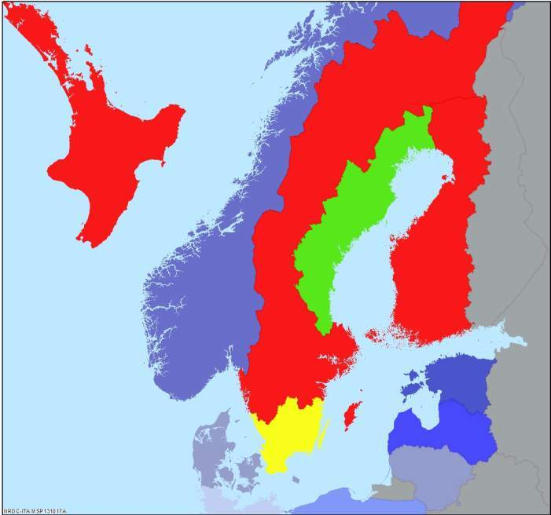
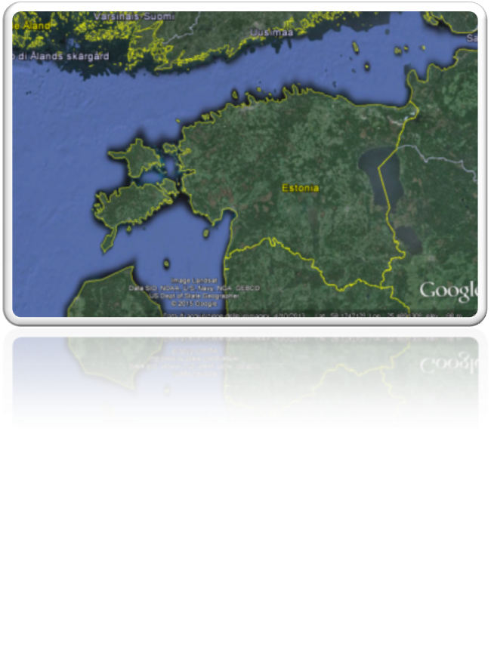
SKOLKAN SCENARIO
Economic & Social Unrest in BDR
Opposing State
Economic crisis in ARN
Friendly State
NOM & AIS Terrorist activities on the rise Region-wide
Neutral State
“The Unknown” Cyber Campaign
Failing State
Relocation of Pharos Group to EST
NATO Countries
Disputed Waters in Gulf of Finland
Increased TOR/BDR Military Activity
Lindsey
Increased BDR pressure on EST
Trondelag Straight
Framland
NATO deployment to EST
Otso
Gulf of Bothnia
Bothnia
Norway
Torrike
NORTH
SEA
Estonia
Russia
Arnland
Latvia
Denmark
Lithuania
Belarus
Germany
Poland

Slide 10
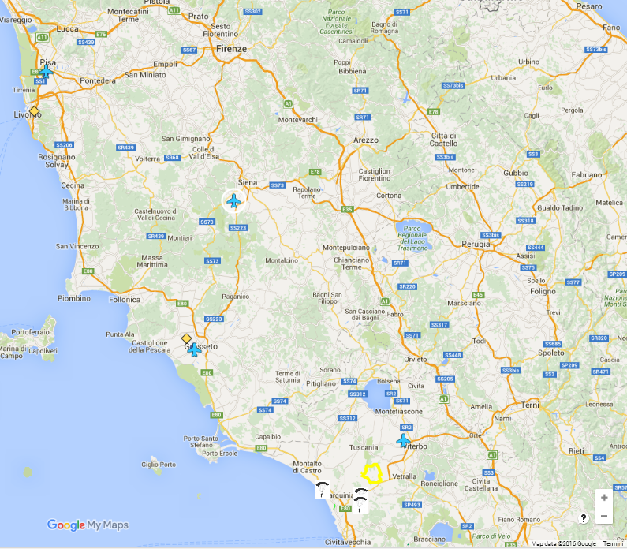
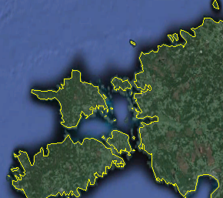
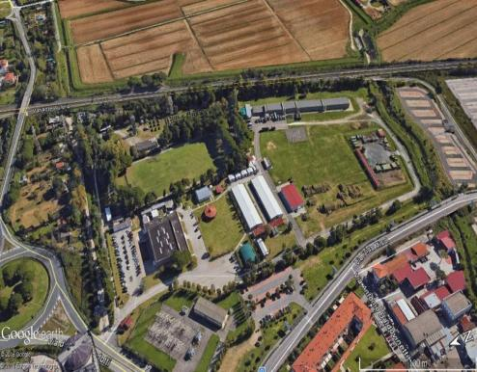
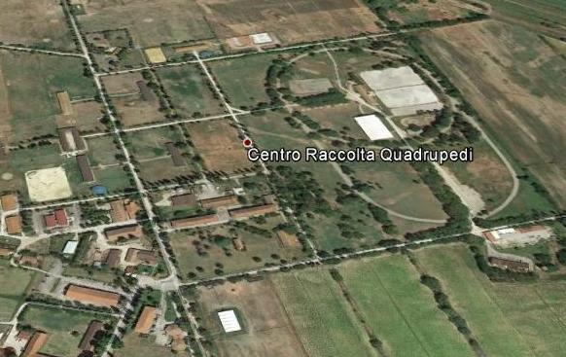
AREA OF THE EXERCISE
BOX1
ISB
1
2
1
AMPUGNANO/KARDLA APOD
ISB
2
M. ROMANO FIRING RANGE /INNER HI. ISLAND/ MANNAMAA
BOX2
PIAN DI SPILLE FIRING RANGE /KORGESSAARE SPOD
Notes:
10

Slide 11
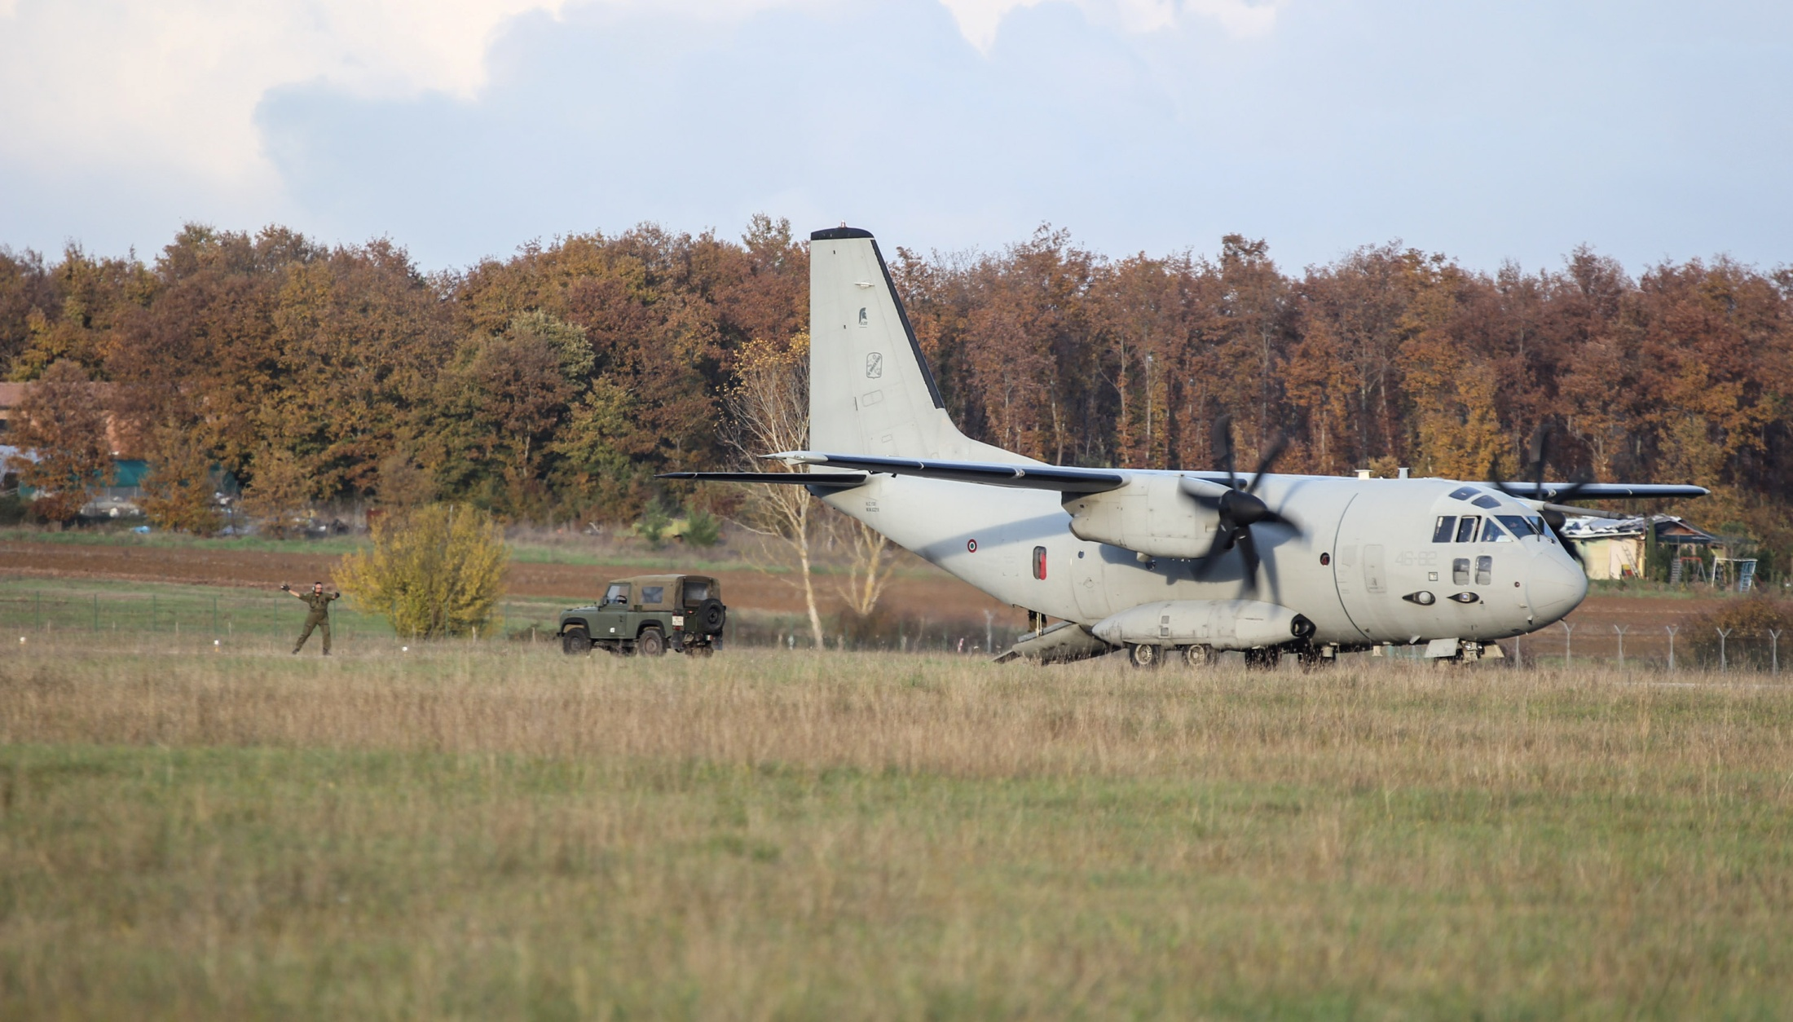
MANGUSTA 2016
“e…per la prima volta…”
Impiego dell’Aeroporto di Ampugnano (Siena)
Atterraggio di un velivolo C27J ITA su Ampugnano
Aviolancio con aerei C130H US impiegando procedure e materiali ITA
Lancio assetti aerei ITA e US in formazione
Impiego della modalità D.A.M.A.* per la gestione di reti multiple su unico canale SAT.
* Demand Assigned Multiple Access

Slide 12
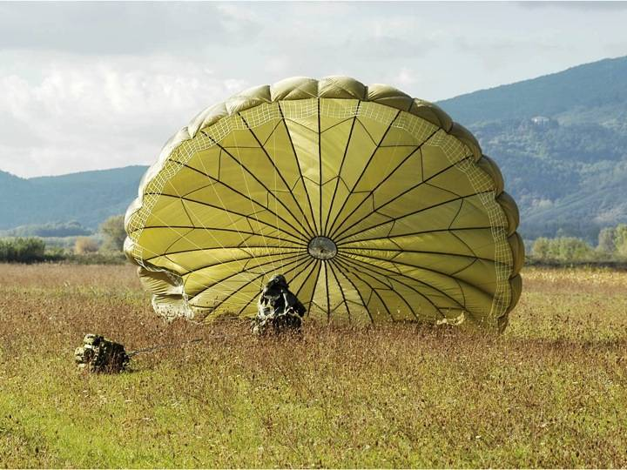
Q&A
Notes:
30/11/2016

Slide 13
PARTICIPANTS
Multinazionali |  | Brigata Folgore |  | Nazionali
USA 173^ IBCT (A) | 140 pax | Cdo Brigata Folgore | 48 pax | Divisione Friuli | 2 pax
USA Air National Guard | 2 C-130 H3 | 187° rgt. par | 22 pax O/C Team | 41° rgt. “Cordenons” | 9 pax
FRA 17° Eng. rgt. | 32 pax | 185° rgt. art. par | 6 pax Staff | 17° rgt. ADA “Sforzesca” | 25 pax
NDL 12° btg. (11°Air Assault Bde) | 31 pax | 186° rgt. par | 190 pax | 5° rgt. “Rigel” | 2 A129 9 PAX
 |  | “Savoia” cav. rgt | 124 pax | 1° rgt. “Antares” | 2 CH47 C/F 26 PAX
 |  | Rgt. Log. Folgore | 87 pax | 1° “Tuscania” rgt. | 18 pax
 |  | 183° rgt. par | 8 pax | 46° Aerobrigata | 1 C130J e 1 C27J
 |  |  | 52 pax | 4° Stormo | APOE
 |  |  | 171 pax | 1° rgt. Granatieri (SIAT) | 51 pax
 |  | 8° rgt. g. par | 32 pax | 121° rgt. ADA | 12 pax
 |  |  | 3 pax | 33° EW | 15 pax
 |  | Capar | 10 pax |  | 5 pax
 |  | Rcst | 116 pax | 2° rgt. trasmissioni | 15 pax
Totale: 204 pax |  | Totale: 913 pax |  | Totale: 187 pax
TOTALE: 1304 pax
DIREX
BLUFOR
OPFOR
REAL LIFE
SUPPORT

